Slide 1
San Francisco Police Department Data Science Interview Project
Justin Irving
2/1/2024

Slide 2
Problem Statement
The San Francisco Fire Department (SFFD) must inspect properties designated as R-2 annually.
The Housing Inspection Services (HIS) division of the Department of Building Inspections (DBI) must conduct routine inspections of properties designated as R-2 at least once every five years.
Question: how can SFFD and DBI prioritize their R-2 inspections to ensure that they are inspecting and identifying the highest risk buildings?

Slide 3
Questions and Initial Reasoning
What defines a “high-risk” building?
Buildings that received a previous violation (SFFD or DBI) during a routine or complaint investigation.
Buildings that previously received certain types of violations associated with hazardous conditions.
Buildings prone to a fire incident or injury.
What are the benefits of prioritization?
“High-risk” buildings can be investigated more often to reduce likelihood of safety incident.
Focusing on “high-risk” buildings will help both departments make the most of their time and resources.
Note: if this were not a practice project, stakeholders would have been engaged at the beginning to define their concerns and drive analysis.

Slide 4
Approach
Deep dive into data
Understand structure, clean data, perform joins.
Perform basic feature engineering as deemed necessary
Check for significant parcel features that correlate with incidents and/or violations.
Features considered include: property age, construction type, use definition.
Cross-reference violations from DBI and SFFD as an additional feature.
Create classification models and check accuracy for SFFD/DBI violations and SFFD incidents.
Provide recommendations based on data understanding and analysis.

Slide 5
Assumptions
R-2 Buildings are parcels that have historically been inspected by the SFFD under the inspection_type_description “R2 Company Inspection”
Tried to classify R-2’s using custom logic based on assessor data and criteria from the problem statement, but SFFD inspection data was used for this initial analysis.
In practice, this would have been resolved with subject matter experts (SME) before analysis.
Fire incident data:
Incidents that did not correspond to a parcel were removed (e.g. car fires at intersection).
Fire incident data pertaining to a parcel was filtered to only include the codes for building fire to only focus on events that could have been precipitated by a building issue.
In practice, these assumptions would also be discussed and reconsidered with input from SME’s.

Slide 6
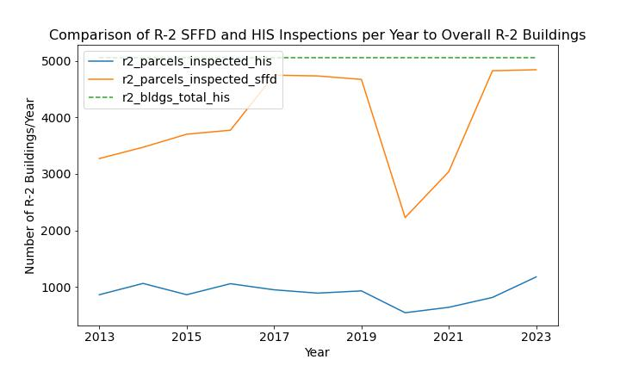
Current Routine Inspection Frequency
Question: is SFFD or DBI having trouble inspecting all R-2 properties at the required frequency?
Answer: No, inspection frequency is meeting requirements.
Findings:
Based on our definition of R-2 parcels both agencies meet inspection frequency requirements.
SFFD inspects nearly all every year which is the goal.
HIS conducts routine inspections of R-2 about once every five year which is the goal.

Slide 7
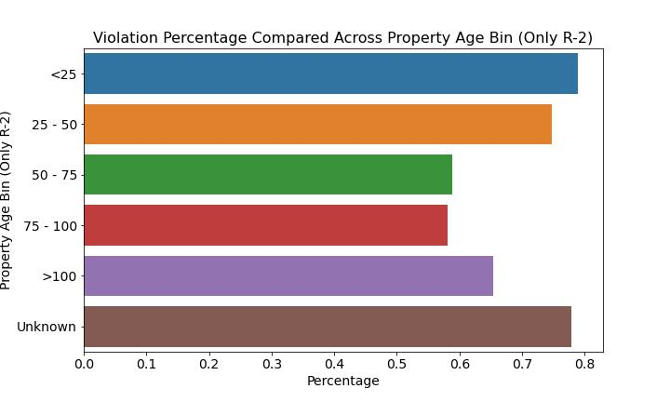
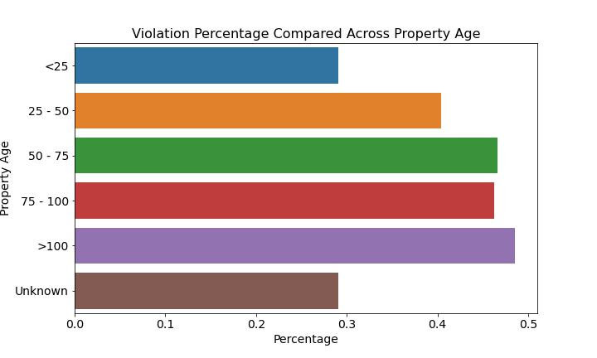
Factors that Relate to SFFD and HIS Violations
Definitions:
For SFFD, violation percentage is calculated as percentage of R-2 parcels with a violation across the factor.
For HIS, violation percentage is calculated as percentage of R-2 inspections with a violation across the factor.
Question: do certain factors relate to increased likelihood of a building inspection violation?
Answer: Yes, but causality needs to be considered further.
Findings:
Property Age
SFFD shows more violations for newer properties.
HIS shows more violations for older properties.
Construction Type
Both data sets show differences in violations across construction type, this could be useful in modeling.
Cross-referencing against SFFD/DBI violations for the same parcel did not appear to have predictive qualities.

Slide 8
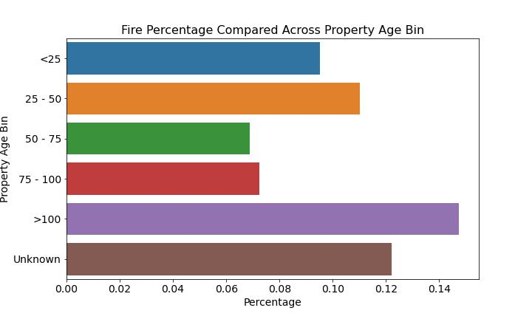
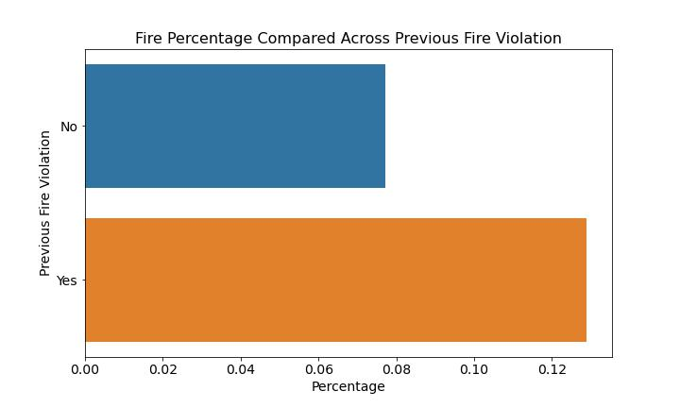
Factors that Relate to SFFD Incidents
Definition: SFFD incident percentage is defined as number of parcels in group with incident divided by all parcels in group in assessor active parcels. Figures in this slide are for R-2 parcels only.
Question: do certain factors relate to increased likelihood of a building fire incident?
Answer: Yes, but causality needs to be considered further.
Findings:
Older and newer properties seem to have higher incident rates than 50 – 100 year-old properties
Construction type shows differences in incident rates.
Previous Fire Violations and DBI Violations seem to be a relatively strong indicator of fire incidents at a parcel.

Slide 9
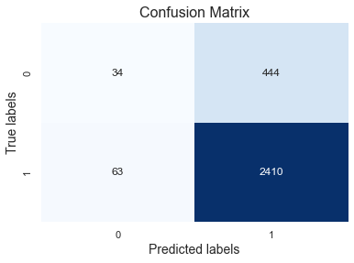
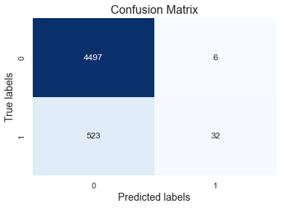
Modeling to Classify Violations and Incidents
HIS Violation Prediction Confusion Matrix
Question: can we create a classifier model that predicts whether a parcel will have a violation or incident at a better probability than what we see in the historical rates?
Impact: if successful, classifier model could help us prioritize high probability parcels first and these represent riskier buildings.
Answer: Yes, but…
SFFD Incident classification better than SFFD violation classification.
HIS violation classification performed well compared to historical violation rate.
Causality needs to be considered further.
Detailed Findings:
Used random forest classifier with factors deemed interesting in initial analysis.
Classification models perform better than historical rates meaning output can be used to prioritize certain inspections.
Incident Prediction Confusion Matrix

Slide 10
Next Steps
Meet with stakeholders to confirm understanding of the following:
Definition of “high-risk” buildings.
Benefits of inspection prioritization and how it can be used to improve operations.
Confirm/determine “base truth” logic for identifying R-2 parcels.
Gain better understanding of assessor variables and reconsider how they could be used in analysis.
Additional analysis to:
Consider adding available building permit information to analysis so recent construction can be targeted.
Conduct more complex joining between violation flags from DBI to SFFD and vice-versa.
Research available tools and methods for prioritizing fire inspections (e.g. Property Inspection Tool)
Data Housekeeping
Functionalize more code, additional commenting
Set-up SQL transformations (if that is how intermediate data is ultimately stored) in dbt
Tie entire data pipeline together using orchestration tool (e.g. Airflow)

Slide 11
Recommendations to Improve Data Sources
SFFD
Standardize primary situation in fire incident data.
DBI
Provide addition select boxes for complain types on complaint form (appears to be mainly text).
Use NLP to pull out keywords from text fields.
Communicate active fire-related complaints. associated with R-2 to SFFD for prioritization.
Perform additional NLP on violations text to enrich data on violation concern.
Standardize action_taken_primary field in fire incident data.
Integrate parcel spatial join into SFFD data pipelines so it doesn’t need to be done after the fact (single source of truth).
Integrate real-time flag in SFFD R-2 database for pending/recent DBI violations
Integrate real-time flag in DBI R-2 database for pending/recent SFFD violations

Slide 12



Additional Information and Resources
All code is on my GitHub repository available at: https://github.com/justinirving314/sfpd_ds_question.git

